Slide 1
Securing Site-to-Site Connectivity VPN and Tunneling
Connecting Networks (CCNA4)- Chapter 7
CCNA Routing and Switching- Todd Lammle- Chapter 12
Notes:
Cisco Networking Academy program
Connecting Networks
Chapter 7: Securing Site-to-Site Connectivity

Slide 2
Chapter 7: Securing Site-to-Site Connectivity
7.1 VPNs
7.2 Site-to-Site GRE Tunnels
7.3 Introducing IPsec
7.4 Remote Access
7.5 Summary
Notes:
Chapter 7

Slide 3
Introduction
A company wanting to connect two (or more) of its sites can choose from several different types of WAN services:
Leased lines
Frame Relay
Multiprotocol Label Switching (MPLS)
But all these services are typically expensive.
Cheaper option available
Different sites can send data to each other using the public Internet as a wide area network (WAN).
But there is one problem….

Slide 4
Virtual Private Network
Security is a concern when using the public Internet to conduct business.
Virtual Private Networks (VPNs) are used to ensure the security of data across the Internet.
A VPN is used to create a private tunnel over a public network.
Data can be secured by using encryption in this tunnel through the Internet and by using authentication to protect data from unauthorized access.

Slide 5
7.1 VPNs
Notes:
7.1 VPNs

Slide 6
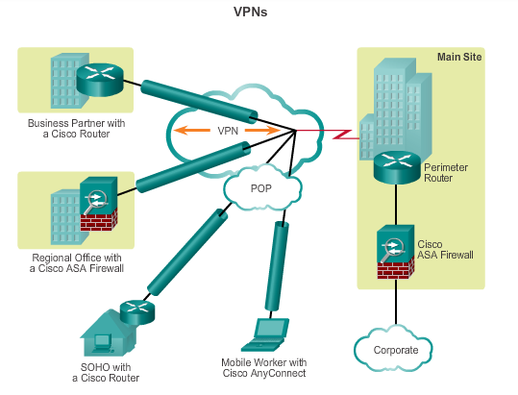
Introducing VPNs
VPNs are used to create an end-to-end private network connection over third-party networks, such as the Internet or extranets.
To implement VPNs, a VPN gateway is necessary: Could be a router, a firewall, or a Cisco Adaptive Security Appliance (ASA).
Notes:
7.1.1.1 Introducing VPNs

Slide 7
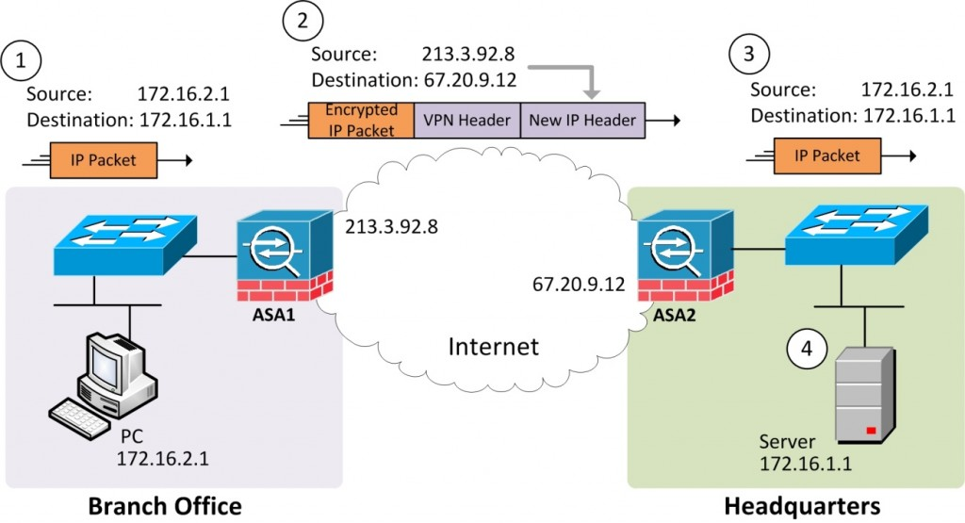
Introducing VPNs
The VPN end points encrypt the whole of original IP packet
The VPN end points also append headers to the original encrypted packet.
The additional headers include fields that allow VPN devices to perform all their functions.

Slide 8
Fundamentals of VPNs Benefits of VPNs
Cost savings
Enable organizations to use cost-effective, third-party Internet transport to connect remote offices and remote users to the main site.
Scalability
Enable organizations to use the Internet infrastructure within ISPs and devices, which makes it easy to add new users.
Notes:
7.1.1.2 Benefits of VPNs

Slide 9
Fundamentals of VPNs Benefits of VPNs (cont.)
Compatibility with broadband technology
Allow mobile workers and telecommuters to take advantage of high-speed, broadband connectivity, such as DSL and cable, to gain access to the networks of their organization, providing workers flexibility and efficiency.
Provide a cost-effective solution for connecting remote offices.
Security
Can include security mechanisms that provide the highest level of security by using advanced encryption and authentication protocols that protect data from unauthorized access.
Notes:
7.1.1.2 Benefits of VPNs

Slide 10
Types of VPNs Site-to-Site VPNs
Connect entire networks to each other, in the past, a leased line or Frame Relay connection was required to connect sites, but because most corporations now have Internet access, these connections can be replaced with site-to-site VPNs.
Internal hosts have no knowledge that a VPN exists.
Created when devices on both sides of the VPN connection are aware of the VPN configuration in advance.
Notes:
7.1.2.1 Site-to-Site VPNs

Slide 11
Types of VPNs Site-to-Site VPNs (cont.)
End hosts send and receive normal TCP/IP traffic through a VPN gateway.
The VPN gateway is responsible for encapsulating and encrypting outbound traffic for all traffic from a particular site
The VPN gateway then sends it through a VPN tunnel over the Internet to a peer VPN gateway at the target site.
Upon receipt, the peer VPN gateway strips the headers, decrypts the content, and relays the packet toward the target host inside its private network.
Notes:
7.1.2.1 Site-to-Site VPNs

Slide 12
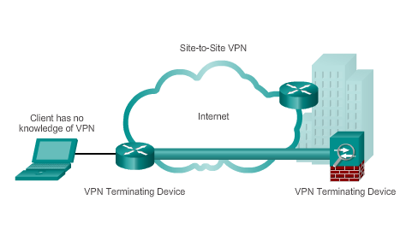
Types of VPNs Site-to-Site VPNs (cont.)
Notes:
7.1.2.1 Site-to-Site VPNs

Slide 13
Types of VPNs Remote Access VPNs
Support the needs of telecommuters, mobile users, and extranet, consumer-to-business traffic.
Support a client/server architecture, where the VPN client (remote host) gains secure access to the enterprise network via a VPN server device at the network edge.
Used to connect individual hosts that must access their company network securely over the Internet.
VPN client software may need to be installed on the mobile user’s end device (Cisco AnyConnect Secure Mobility Client).
When the host tries to send any traffic, the VPN Client software encapsulates and encrypts this traffic and sends over the Internet to the VPN gateway at the edge of the target network.
Notes:
7.1.2.2 Remote Access VPNs

Slide 14
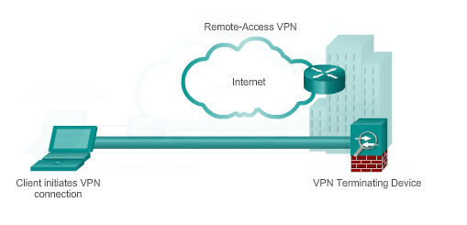
Types of VPNs Remote Access VPNs (cont.)
Notes:
7.1.2.2 Remote Access VPNs

Slide 15
Tunneling Protocols Site-to-Site GRE Tunnels
Notes:
7.2 Site-to-Site GRE Tunnels

Slide 16
Types of Tunneling Protocols Introduction to Tunneling Protocols
Layer 2 Forwarding (L2F):
developed by Cisco
bare bones tunneling protocol, does not provide encryption by itself.
relies on the protocol being tunneled to provide encryption and confidentiality.
Point-to-Point Tunneling Protocol (PPTP):
created by Microsoft
uses a control channel over TCP to send control packets and a GRE tunnel to encapsulate PPP data packets.
relies on the tunneled PPP to implement security.

Slide 17
Types of Tunneling Protocols Introduction to Tunneling Protocols
Layer 2 Tunnel Protocol (L2TP):
L2TP is an Internet Engineering Task Force (IETF) standard
combines the best features of Cisco Layer 2 Forwarding (L2F) and Microsoft Point-to-Point Tunneling Protocol (PPTP)
Generic Routing Encapsulation (GRE):
GRE is a tunneling protocol developed by Cisco that can be used to encapsulate a wide variety of other protocols inside IP tunnels.
GRE is the Swiss Army knife of tunneling protocols as it can be used to create a virtual point-to-point link between end point devices over an IP network that can carry data packets from a variety of different protocols.

Slide 18
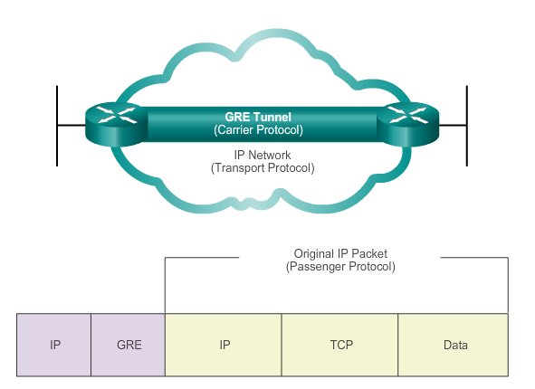
Fundamentals of Generic Routing Encapsulation Introduction to GRE
Basic, non-secure, site-to-site VPN tunneling protocol developed by Cisco
Encapsulates a wide variety of protocol packet types inside IP tunnels
Creates a virtual point-to-point link to routers at remote points, over an IP internetwork
Notes:
7.2.1.1 Introduction to GRE

Slide 19
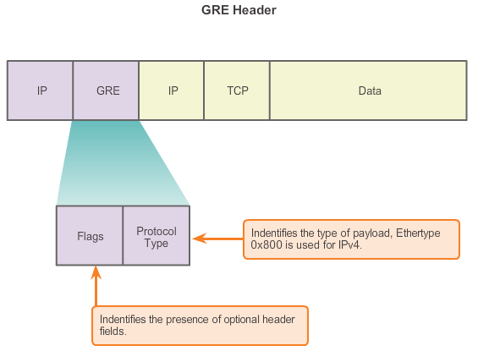
Fundamentals of Generic Routing Encapsulation Characteristics of GRE
Notes:
7.2.1.2 Characteristics of GRE

Slide 20
Fundamentals of Generic Routing Encapsulation Characteristics of GRE
GRE has these characteristics:
GRE is defined as an IETF standard.
IP protocol 47 is used to identify GRE packets.
GRE encapsulation uses a protocol type field in the GRE header to support the encapsulation of any OSI Layer 3 protocol.
GRE itself is stateless; it does not include any flow-control mechanisms, by default.
GRE does not include any strong security mechanisms to protect its payload.
The GRE header, together with the tunneling IP header, creates at least 24 bytes of additional overhead for tunneled packets.
Notes:
7.2.1.2 Characteristics of GRE

Slide 21
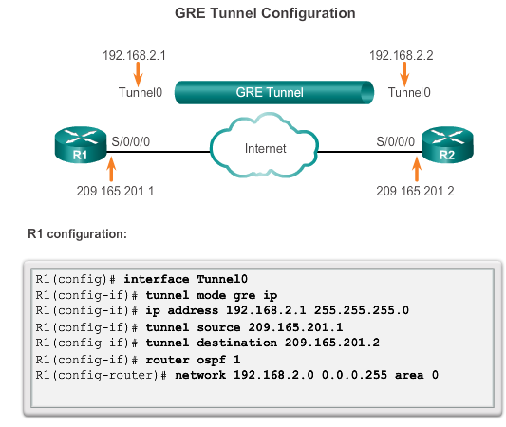
Configuring GRE Tunnels GRE Tunnel Configuration
Notes:
7.2.2.1 GRE Tunnel Configuration

Slide 22
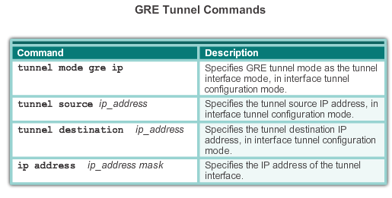
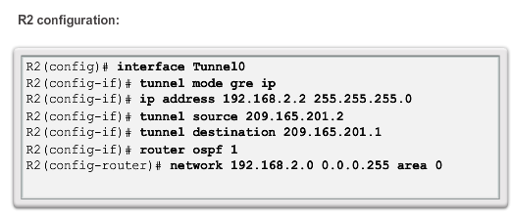
Configuring GRE Tunnels GRE Tunnel Configuration
Notes:
7.2.2.1 GRE Tunnel Configuration

Slide 23
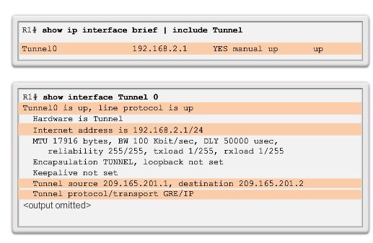
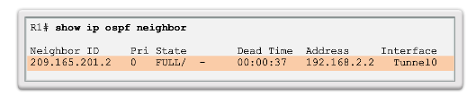
Configuring GRE Tunnels GRE Tunnel Verification
Verify Tunnel
Interface is Up
Verify OSPF Adjacency
Notes:
7.2.2.2 GRE Tunnel Verification

Slide 24
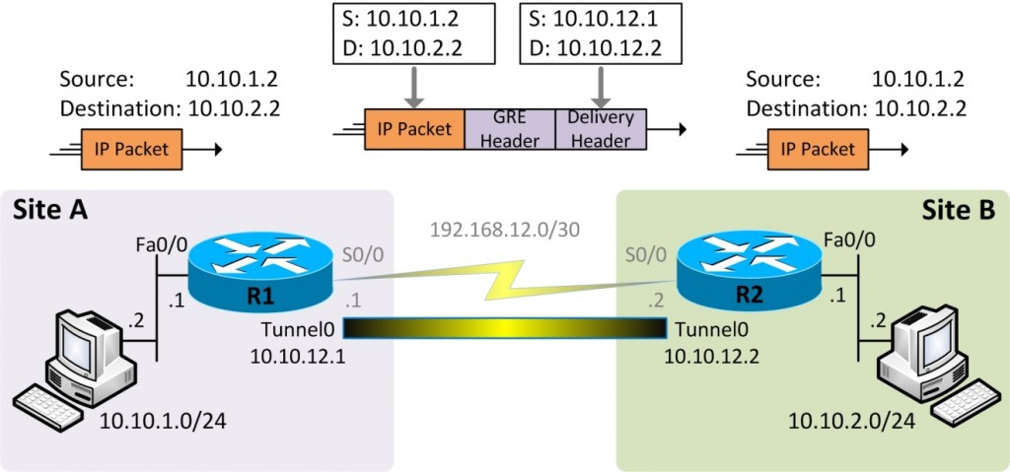
Configuring GRE Tunnels GRE Tunnel Verification
Generic Routing Encapsulation (GRE) tunnels work just like a serial link, with virtual tunnel interfaces replacing physical serial interfaces.

Slide 25
R1 Configuration
R1(config)#interface Tunnel 0 R1(config-if)#ip address 10.10.12.1 255.255.255.252 R1(config-if)#tunnel source Serial0/0 R1(config-if)#tunnel destination 192.168.12.2 R1(config-if)#no shutdown R1(config)# ip route 10.10.2.0 255.255.255.0 192.168.12.2 R1(config)#ip route 10.10.2.0 255.255.255.0 10.10.12.2

Slide 26
R2 Configuration
R2(config)#interface Tunnel 0 R2(config-if)#ip address 10.10.12.2 255.255.255.252 R2(config-if)#tunnel source Serial0/0 R2(config-if)#tunnel destination 192.168.12.1 R2(config-if)#no shutdown R2(config)#ip route 10.10.1.0 255.255.255.0 192.168.12.1 R2(config)#ip route 10.10.1.0 255.255.255.0 10.10.12.1

Slide 27
Verification
R1#show ip interface brief Interface IP-Address OK? Method Status Protocol FastEthernet0/0 10.10.1.1 YES manual up up Serial0/0 192.168.12.1 YES manual up up Tunnel0 10.10.12.1 YES manual up up
R2#show ip interface brief Interface IP-Address OK? Method Status Protocol FastEthernet0/0 10.10.2.1 YES manual up up Serial0/0 192.168.12.2 YES manual up up Tunnel0 10.10.12.2 YES manual up up

Slide 28
Verification
R1#show interfaces tunnel 0 Tunnel0 is up, line protocol is up Hardware is Tunnel Internet address is 10.10.12.1/30 MTU 1514 bytes, BW 9 Kbit, DLY 500000 usec, reliability 255/255, txload 1/255, rxload 1/255 Encapsulation TUNNEL, loopback not set Keepalive not set Tunnel source 192.168.12.1, destination 192.168.12.2 Tunnel protocol/transport GRE/IP Key disabled, sequencing disabled Checksumming of packets disabled Tunnel TTL 255 Fast tunneling enabled Tunnel transmit bandwidth 8000 (kbps) Tunnel receive bandwidth 8000 (kbps) Last input 00:28:44, output 00:28:44, output hang never <Some output omitted>

Slide 29
Verification
R1#show ip route <Some output omitted>
192.168.12.0/30 is subnetted, 1 subnets C 192.168.12.0 is directly connected, Serial0/0 10.0.0.0/8 is variably subnetted, 3 subnets, 2 masks C 10.10.1.0/24 is directly connected, FastEthernet0/0 S 10.10.2.0/24 [1/0] via 10.10.12.2 C 10.10.12.0/30 is directly connected, Tunnel0

Slide 30
Verification
We can run a traceroute to verify that traffic passes through the tunnel and find out the path taken by packets:
Tracing the route to 10.10.2.1
1 10.10.12.2 0 msec 4 msec 0 msec
2 10.10.2.2 4 msec 4 msec 0 msec
You may have noticed that the traceroute does not list any IP addresses on the serial interfaces of routers though the traffic physically passes through them. The reason is that the packets sent by traceroute are encapsulated before being sent from R1 to R2.

Slide 31
7.3 Introducing IPsec
Notes:
7.3 Introducing IPsec

Slide 32
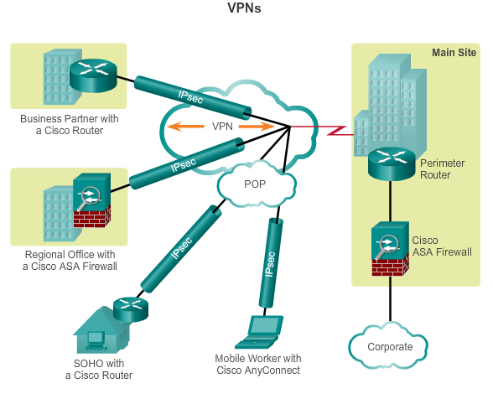
Internet Protocol Security IPsec VPNs
Information from a private network is securely transported over a public network.
Forms a virtual network instead of using a dedicated Layer 2 connection.
To remain private, the traffic is encrypted to keep the data confidential.
Notes:
7.3.1.1 IPsec

Slide 33
Internet Protocol Security IPsec Functions
Defines how a VPN can be configured in a secure manner using IP.
Not bound to any specific encryption, authentication, security algorithms, or keying technology – Open Standard
Relies on existing algorithms to implement secure communications.
Works at the network layer, protecting and authenticating IP packets between participating IPsec devices.
Secures a path between a pair of gateways, a pair of hosts, or a gateway and host.
All implementations of IPsec have a plaintext Layer 3 header, so there are no issues with routing.
Functions over all Layer 2 protocols, such as Ethernet, ATM, or Frame Relay.
Notes:
7.3.1.1 IPsec

Slide 34
Internet Protocol Security IPsec Characteristics
IPsec characteristics can be summarized as follows:
IPsec is a framework of open standards that is algorithm-independent.
IPsec provides data confidentiality, data integrity, and origin authentication.
IPsec acts at the network layer, protecting and authenticating IP packets.
Notes:
7.3.1.1 IPsec

Slide 35
Internet Protocol Security IPsec Security Services
Confidentiality (encryption) – encrypt the data before transmitting across the network
Data integrity – verify that data has not been changed while in transit, if tampering is detected, the packet is dropped
Authentication – verify the identity of the source of the data that is sent, ensures that the connection is made with the desired communication partner, IPsec uses Internet Key Exchange (IKE) to authenticate users and devices that can carry out communication independently.
Anti-Replay Protection – detect and reject replayed packets and helps prevent spoofing
CIA: confidentiality, integrity, and authentication
Notes:
7.3.1.2 IPsec Security Services

Slide 36
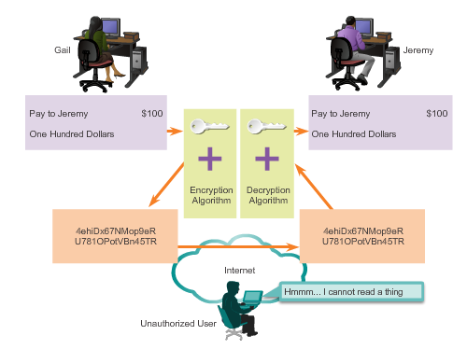
IPsec Framework Confidentiality with Encryption
For encryption to work, both the sender and the receiver must know the rules used to transform the original message into its coded form.
Rules are based on algorithms and associated keys.
Decryption is extremely difficult (or impossible) without the correct key.
Notes:
7.3.2.1 Confidentiality with Encryption

Slide 37
IPsec Framework Encryption Algorithms
As key length increases, it becomes more difficult to break the encryption. However, a longer key requires more processor resources when encrypting and decrypting data.
Two main types of encryption are:
Symmetric Encryption
Asymmetric Encryption
Notes:
7.3.2.2 Encryption Algorithms

Slide 38
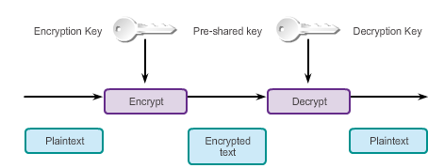
IPsec Framework Symmetric Encryption
Encryption and decryption use the same key.
Each of the two networking devices must know the key to decode the information.
Does not require a lot of computational power
Also run on network devices even without dedicated cryptography hardware due to being less computationally intensive.
Notes:
7.3.2.2 Encryption Algorithms

Slide 39
IPsec Framework Symmetric Encryption
Examples:
Data Encryption Standard (DES)
Triple DES (3DES)
Advance Encryption Standard (AES)

Slide 40
IPsec Framework Symmetric Encryption
Algorithm | Key Length (bits) | Block Length (bits) | Security
DES | 56 | 64 | Insecure
3DES | 168 (3 times 56) | 64 | Relatively secure
AES | 128, 192, or 256 | 128, 192, or 256 | Strong

Slide 41
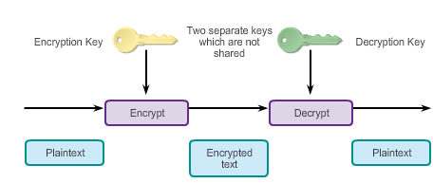
IPsec Framework Asymmetric Encryption
Uses different keys for encryption and decryption.
Knowing one of the keys does not allow a hacker to deduce the second key and decode the information.
One key encrypts the message, while a second key decrypts the message.
Public key encryption is a variant of asymmetric encryption that uses a combination of a private key and a public key.
Notes:
7.3.2.2 Encryption Algorithms

Slide 42
IPsec Framework Asymmetric Encryption
Public-key cryptography, uses a two-key pair: one key is used to encrypt plaintext while the other key is used to decrypt the ciphertext.
Each end user has its own pair of public and private keys.
The public key of each end user is publicly available via a key management system.
The private key is known only to the end user and is never exchanged or revealed to anyone other than the end user.

Slide 43
IPsec Framework Asymmetric Encryption
Is typically used in the key management process of VPN establishment, though it is not used to encrypt data being computationally intensive
RSA: The RSA algorithm derives its name from the surnames of its three developers, Rivest, Shamir, and Adleman. It can be used for key exchange, digital signatures, and message encryption.
Diffie-Hellman (DH): DH is used for exchanging keys over an insecure medium, between two end users that have no prior knowledge of each other.

Slide 44
IPsec Framework Diffie-Hellman Key Exchange
Diffie-Hellman (DH) is not an encryption mechanism and is not typically used to encrypt data.
DH is a method to securely exchange the keys that encrypt data.
DH is part of the IPsec standard.
Encryption algorithms, such as DES, 3DES, and AES, as well as the MD5 and SHA-1 hashing algorithms, require a symmetric, shared secret key to perform encryption and decryption.
DH algorithm specifies a public key exchange method that provides a way for two peers to establish a shared secret key that only they know, although they are communicating over an insecure channel.
Based on mathematical sequence of steps
Notes:
7.3.2.3 Diffie-Hellman Key Exchange

Slide 45
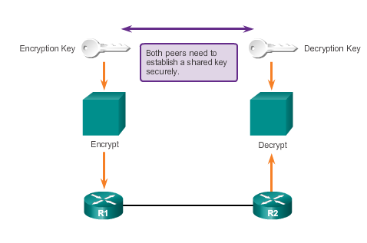
IPsec Framework Diffie-Hellman Key Exchange
Notes:
7.3.2.3 Diffie-Hellman Key Exchange

Slide 46
IPsec Framework Integrity with Hash Algorithms
The original sender generates a hash of the message and sends it with the message itself.
The recipient parses the message and the hash, produces another hash from the received message, and compares the two hashes.
If they are the same, the recipient can be reasonably sure of the integrity of the original message.
Notes:
7.3.2.4 Integrity with Hash Algorithms

Slide 47
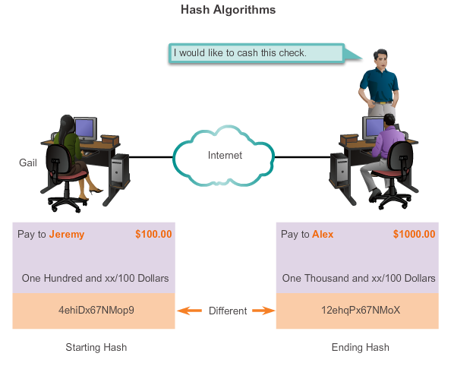
IPsec Framework Integrity with Hash Algorithms (cont.)
Notes:
7.3.2.4 Integrity with Hash Algorithms

Slide 48
IPsec Framework Integrity with Hash Algorithms (cont.)
Hash-based Message Authentication Code (HMAC) is a mechanism for message authentication using hash functions.
HMAC has two parameters: A message input and a secret key known only to the message originator and intended receivers.
Message sender uses an HMAC function to produce a value (the message authentication code) formed by condensing the secret key and the message input.
Message authentication code is sent along with the message.
Receiver computes the message authentication code on the received message using the same key and HMAC function as the sender used.
Receiver compares the result that is computed with the received message authentication code.
If the two values match, the message has been correctly received and the receiver is assured that the sender is a user community member who share the key.
Notes:
7.3.2.4 Integrity with Hash Algorithms

Slide 49
IPsec Framework Integrity with Hash Algorithms (cont.)
There are two common HMAC algorithms:
MD5 – Uses a 128-bit shared secret key. The variable-length message and 128-bit shared secret key are combined and run through the HMAC-MD5 hash algorithm. The output is a 128-bit hash. The hash is appended to the original message and forwarded to the remote end.
SHA – SHA-1 uses a 160-bit secret key. The variable-length message and the 160-bit shared secret key are combined and run through the HMAC-SHA1 hash algorithm. The output is a 160-bit hash. The hash is appended to the original message and forwarded to the remote end.
Notes:
7.3.2.4 Integrity with Hash Algorithms

Slide 50
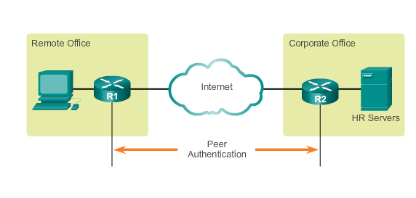
IPsec Framework IPsec Authentication
IPsec VPNs support authentication.
Device on the other end of the VPN tunnel must be authenticated before the communication path is considered secure.
Notes:
7.3.2.5 IPsec Authentication

Slide 51
IPsec Framework IPsec Authentication (cont.)
There are two peer authentication methods, PSK and RSA signatures:
PSK
A secret key shared between the two parties using a secure channel before it needs to be used.
Use symmetric key cryptographic algorithms.
A PSK is entered into each peer manually and is used to authenticate the peer.
Notes:
7.3.2.5 IPsec Authentication

Slide 52
IPsec Framework IPsec Authentication (cont.)
RSA signatures
Digital certificates are exchanged to authenticate peers.
Local device derives a hash and encrypts it with its private key.
Encrypted hash, or digital signature, is attached to the message and forwarded to the remote end.
At the remote end, the encrypted hash is decrypted using the public key of the local end.
If the decrypted hash matches the recomputed hash, the signature is genuine.
Notes:
7.3.2.5 IPsec Authentication

Slide 53
IPsec Framework IPsec Protocol Framework
Authentication Header (AH)
Appropriate protocol to use when confidentiality is not required or permitted.
Provides data authentication and integrity for IP packets that are passed between two systems.
Does not provide data confidentiality (encryption) of packets.
Encapsulating Security Payload (ESP)
A security protocol that provides confidentiality and authentication by encrypting the IP packet.
Authenticates the inner IP packet and ESP header.
Both encryption and authentication are optional in ESP, at a minimum, one of them must be selected.
Notes:
7.3.2.6 IPsec Protocol Framework

Slide 54
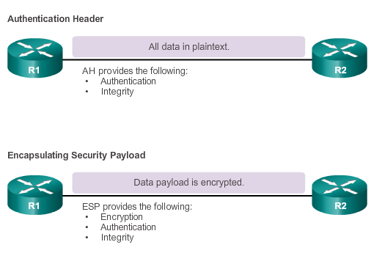
IPsec Framework IPsec Protocol Framework (cont.)
Notes:
7.3.2.6 IPsec Protocol Framework

Slide 55
IPsec Framework IPsec Protocol Framework (cont.)
Four basic building block of the IPsec framework that must be selected:
IPsec framework protocol – A combination of ESP and AH, ESP or ESP+AH options are almost always selected because AH itself does not provide encryption.
Confidentiality (if IPsec is implemented with ESP) – DES, 3DES, or AES, AES is strongly recommended since provides the greatest security.
Integrity – Guarantees that the content has not been altered in transit using hash algorithms (MD5 or SHA).
Authentication – Represents how devices on either end of the VPN tunnel are authenticated (PSK or RSA).
DH algorithm group – Represents how a shared secret key is established between peers, DH24 provides the greatest security.
Notes:
7.3.2.6 IPsec Protocol Framework

Slide 56
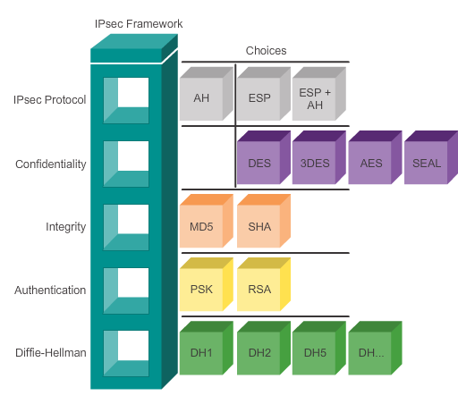
IPsec Framework IPsec Protocol Framework (cont.)
Notes:
7.3.2.6 IPsec Protocol Framework

Slide 57
7.4 Remote Access
Notes:
7.4 Remote Access

Slide 58
Remote Access VPN Solutions Types of Remote Access VPNs
There are two primary methods for deploying remote access VPNs:
Secure Sockets Layer (SSL)
IP Security (IPsec)
Type of VPN method based on the access requirements of the users and the organization’s IT processes.
Both types offer access to virtually any network application or resource.
Notes:
7.4.1.1 Types of Remote Access VPNs

Slide 59
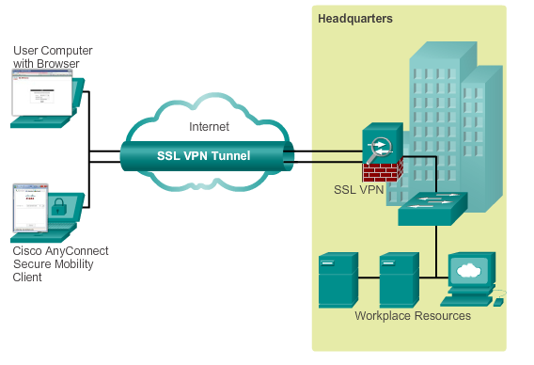
Remote Access VPN Solutions Cisco SSL VPN
Provides remote access by using a web browser and the web browser’s native SSL encryption.
Can provide remote access using the Cisco AnyConnect Secure Mobility Client software
Notes:
7.4.1.2 Cisco SSL VPN

Slide 60
Remote Access VPN Solutions Cisco SSL VPN Solutions
Cisco AnyConnect Secure Mobility Client with SSL
Client-Based SSL VPNs provide authenticated users with LAN-like, full network access to corporate resources
The remote devices require a client application, such as the Cisco VPN Client or the newer AnyConnect client to be installed on the end-user device
Cisco Secure Mobility Clientless SSL VPN
Enables corporations to provide access to corporate resources even when the remote device is not corporately-managed
Cisco ASA is used as a proxy device to network resources
Provides a web portal interface for remote devices to navigate the network using port-forwarding capabilities
Notes:
7.4.1.3 Cisco SSL VPN Solutions

Slide 61
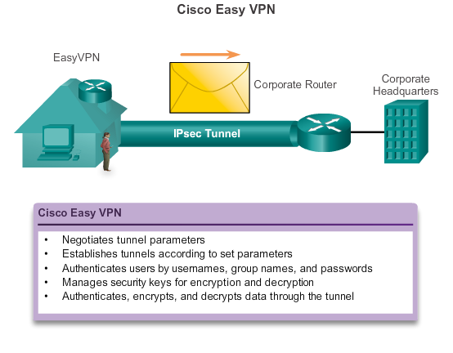
IPsec Remote Access VPNs IPsec Remote Access
Notes:
7.4.2.1 IPsec Remote Access

Slide 62
IPsec Remote Access VPNs IPsec Remote Access (cont.)
The Cisco Easy VPN solution consists of three components:
Cisco Easy VPN Server – A Cisco IOS router or Cisco ASA Firewall acting as the VPN head-end device in site-to-site or remote-access VPNs.
Cisco Easy VPN Remote – A Cisco IOS router or Cisco ASA Firewall acting as a remote VPN client.
Cisco VPN Client – An application supported on a PC used to access a Cisco VPN server.
The Cisco Easy VPN solution feature offers flexibility, scalability, and ease of use for both site-to-site and remote access IPsec VPNs.
Notes:
7.4.2.1 IPsec Remote Access

Slide 63
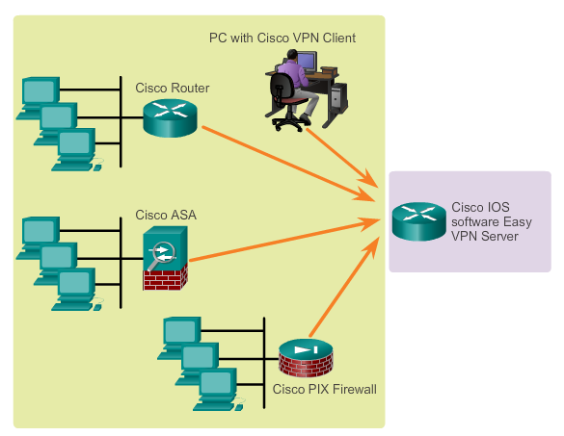
IPsec Remote Access VPNs Cisco Easy VPN Server and Remote
Notes:
7.4.2.2 Cisco Easy VPN Server and Remote

Slide 64
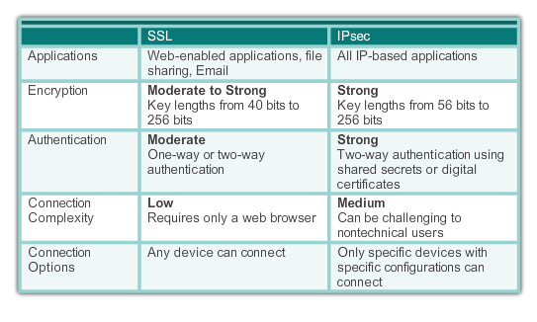
IPsec Remote Access VPNs Comparing IPsec and SSL
Notes:
7.4.2.4 Comparing IPsec and SSL

Slide 65
Chapter 7: Summary
VPNs are used to create a secure end-to-end private network connection over a third-party network, such as the Internet.
A site-to-site VPN uses a VPN gateway device at the edge of both sites. The end hosts are unaware of the VPN and have no additional supporting software.
A remote access VPN requires software to be installed on the individual host device that accesses the network from a remote location.
The two types of remote access VPNs are SSL and IPsec.
SSL technology can provide remote access using a client’s web browser and the browser’s native SSL encryption.
Using Cisco AnyConnect software on the client, users can have LAN-like, full network access using SSL.
Notes:
Chapter 7 Summary

Slide 66
Chapter 7: Summary (cont.)
GRE is a basic, non-secure site-to-site VPN tunneling protocol that can encapsulate a wide variety of protocol packet types inside IP tunnels, thus allowing an organization to deliver other protocols through an IP-based WAN.
Today, it is primarily used to deliver IP multicast traffic or IPv6 traffic over an IPv4 unicast-only connection.
IPsec, an IETF standard, is a secure tunnel operating at Layer 3 of the OSI model that can protect and authenticate IP packets between IPsec peers.
It can provide confidentiality by using encryption, data integrity, authentication, and anti-replay protection.
Data integrity is provided by using a hash algorithm, such as MD5 or SHA.
Authentication is provided by the PSK or RSA peer authentication method.
Notes:
Chapter 7 Summary

Slide 67
Chapter 7: Summary (cont.)
The level of confidentiality provided by encryption depends on the algorithm used and the key length.
Encryption can be symmetrical or asymmetrical.
DH is a method used to securely exchange the keys to encrypt data.
Notes:
Chapter 7 Summary

Slide 68


